Slide 1
On The Spot Delivery
SPRINT 3 Presentation

Slide 2
Driver Stakeholder Functionality
Complete Driver Functionality
Able to manage the flow of packages, from order to pickup, pickup to warehouse check-in and warehouse to delivery recipient.

Slide 3
User stories implemented in Sprint 3
Sprint Three
Story ID | Story Title | MoSCoW | Story Points
SRCX-38 | Driver Management Page | Must Have | 2
SRCX-139 | Package Pickup Form | Could Have | 4
SRCX-138 | Package Check in Form | Could Have | 4
SRCX-140 | Package Delivery Form | Could Have | 6
 | Story Point Sub-Total: |  | 16

Slide 4
Time Estimates
Sprint Three:
- Estimated (102 hours)
- Actual (106 hours)

Slide 5
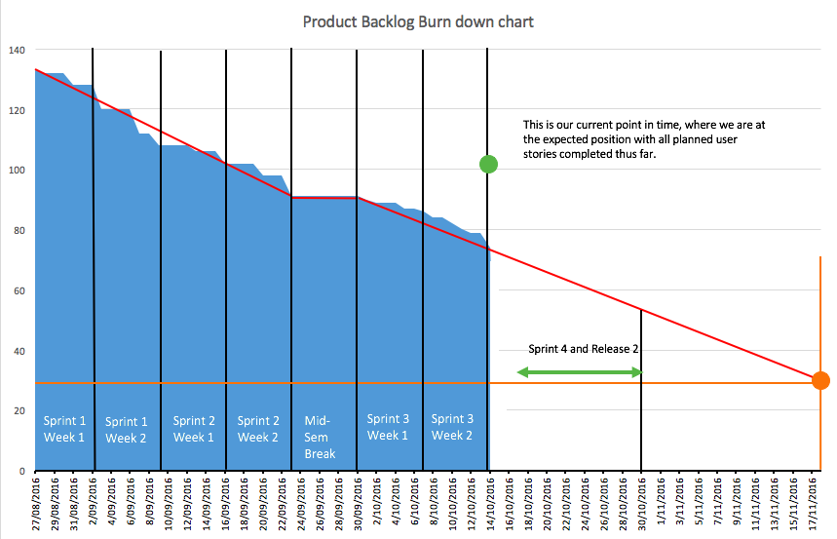
Burn down chart

Slide 6
Demonstration
http://onthespotdelivery.herokuapp.com

